Slide 1
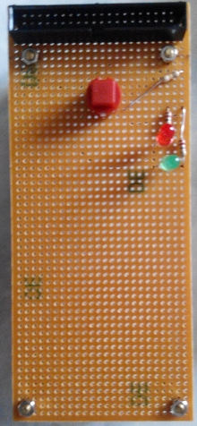


Python Programming
using RPi & I/O board
Lab 3

Slide 2
Learning outcomes:
At the end of this Lab 3, you should be able to:
identify RPi GPIO pins
interface I/O board
control I/O peripherals
complete examples

Slide 3
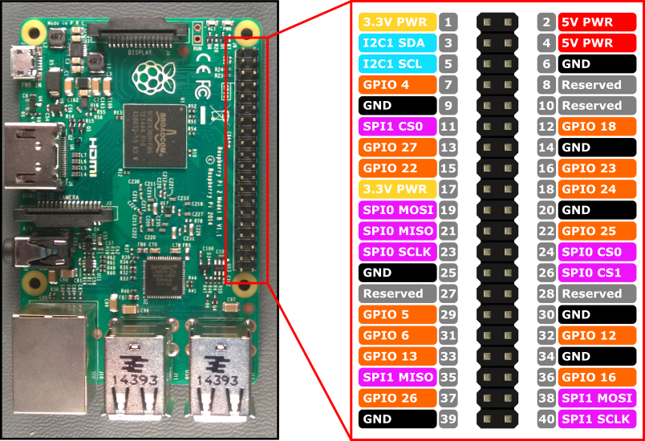
RPi GPIO pin diagram (40 pin)

Slide 4
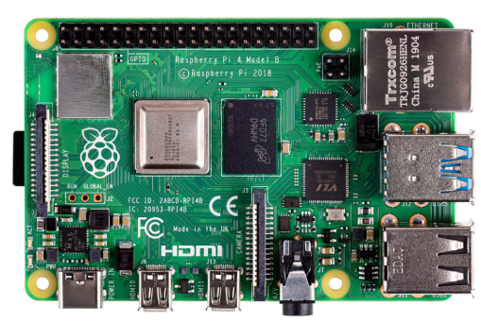
RPi and I/O board:

Slide 5
General Purpose Input Output (GPIO)
Using Python on the RPi opens up the opportunity to connect to the real world through the Pi's GPIO pins. This can be done with the RPi GPIO library. It is preinstalled on recent Raspbian images:
To control the GPIO pins you'll need root access, so run sudo python
In your Python script, import the GPIO module, set the board mode to that of your preference, set up the pins you want to use:
import RPi.GPIO as G
G.setmode(G.BCM) # set board mode to Broadcom
G.setup(27, G.OUT) # set up pin 27
G.setup(22, G.OUT) # set up pin 22
G.output(27, 1) # turn on pin 27
G.output(22, 1) # turn on pin 22

Slide 6
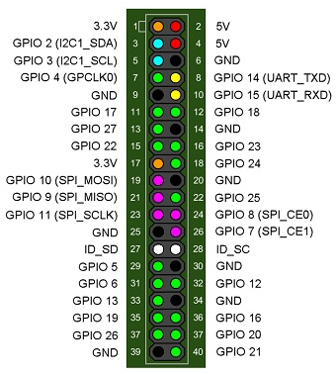
Examples using GPIO
Example G1: Turn ON Red LED
To control GPIO, you need an Adminstrator rights.
Launch LXTerminal
pi@raspberry ~ $ sudo idle
A new shell will be launched, then go to File >New Window
and type the below code:
import RPi.GPIO as G # Import GPIO library
G.setmode(G.BCM) # Use board pin numbering
G.setup(27, G.OUT) # Setup GPIO Pin 27 to OUT
G.output(27, True) # Turn on GPIO pin 27
input(‘Press <Enter> key to turn On LED & exit this prog’)
G.output(27, False)
G.cleanup()
Save the file with any file name (for example G1.py)
Run > Run Module
Then observe the Red LED status

Slide 7
Example G2: Turn OFF Red LED
import RPi.GPIO as G
G.setmode(G.BCM)
G.setup(27, G.OUT)
G.output(27, False) # you can also use 0 or OFF instead of False
input(‘Press <Enter> key to turn On LED & exit this prog’)
G.output(27, True)
G.cleanup()
Save the file with G2.py name
Run > Run Module
Then observe the Red LED status
Modify the above program to turn ON Green LED along with the Red LED.
The Green LED is connected to GPIO 22

Slide 8
Example G3: Blink RED & GREEN LEDs
import RPi.GPIO as G
import time # Import 'time' library. Allows us to use 'sleep'
G.setwarnings(False) # to suppress warning messages
G.setmode(G.BCM)
G.setup(27, G.OUT)
G.setup(22, G.OUT)
G.output(27, True) G.output(22, True)
time.sleep(3) # time in seconds
G.output(27, False) G.output(22, False)
time.sleep(3)
input(‘Hit <Enter> key to exit this prog’)
G.setwarnings(False)
G.cleanup()

Slide 9
Example G4: Using function (Blink RED LED)
import RPi.GPIO as G
import time
G.setmode(G.BCM)
G.setup(27, G.OUT)
#Define a function named Blink()
def Blink(numTimes, length):
for i in range(0, numTimes): # Run loop numTimes
print (“Iteration “ + str(i+1) ) # Print current loop
G.output(27, True) # Turn ON red LED on GPIO 27
time.sleep(length) # Wait
G.output(27, False) # Turn OFF
time.sleep(length) # Wait
print (“Done”) # When loop is complete, print "Done"
G.cleanup()
iterations = input(‘Enter total number of times to blink: ‘)
duration = input(‘Enter duration of each On/Off state(seconds): ‘)
# Start Blink() function. Convert input from strings to numeric data & pass to Blink() Blink(int(iterations), float(duration))

Slide 10
Example G5: Using while (Blink RED LED)
import RPi.GPIO as G
import time
try:
# Set up the G channels
G.setmode(G.BCM)
G.setup(27, G.OUT)
t = 1.5
while True:
G.output(27, True)
time.sleep(t)
G.output(27, False)
time.sleep(t)
except KeyboardInterrupt: #if Ctrl-C is pressed, exit cleanly.
G.cleanup()
Note: Press Ctrl+C to stop the program.

Slide 11
Example G6: Input (GPIO 4)
import RPi.GPIO as G
import time
try:
# Set up the GPIO channels
G.setmode(G.BCM)
G.setup(27, G.OUT)
G.setup(22, G.OUT)
G.setup(4, G.IN)
t = 1.5
while True:
while(G.input(4) == 0):
#pass
print(“You pressed the button”)
G.output(27, True)
G.output(22, True)
time.sleep(t)

Slide 12
Example G6: Input (GPIO 4) continued…
# Note the indentation, type exactly below the time.sleep(t)
G.output(27, False)
G.output(22, False)
time.sleep(t)
except KeyboardInterrupt:
G.cleanup()

Slide 13
Example G6a: Design a counter: Try out!
Using the 2 LEDs and a switch, write a program which counts the number of times you have pressed the switch and display the count on the screen.
Turn ON both the LEDs when the switch is pressed
Turn OFF both the LEDs when the switch is released.

